Slide 1
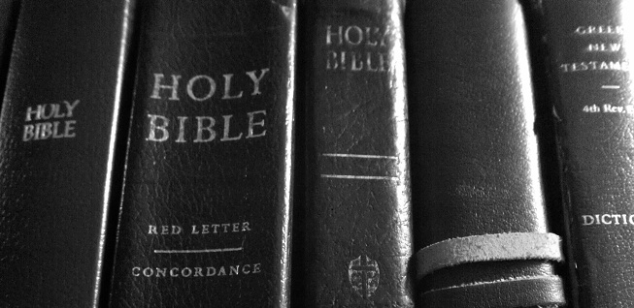
Heritage Basics
Lesson 2: BIBLE Study
Notes:
Objectives of Lesson 2:
I. Motivate you to READ and STUDY the Bible
II. Teach you basic Bible Study Skills
a. We will Review Discuss 5 reasons for knowing God’s Word
b. Review the process of Bible Study
c. Review a practical Bible Study Exercise

Slide 2
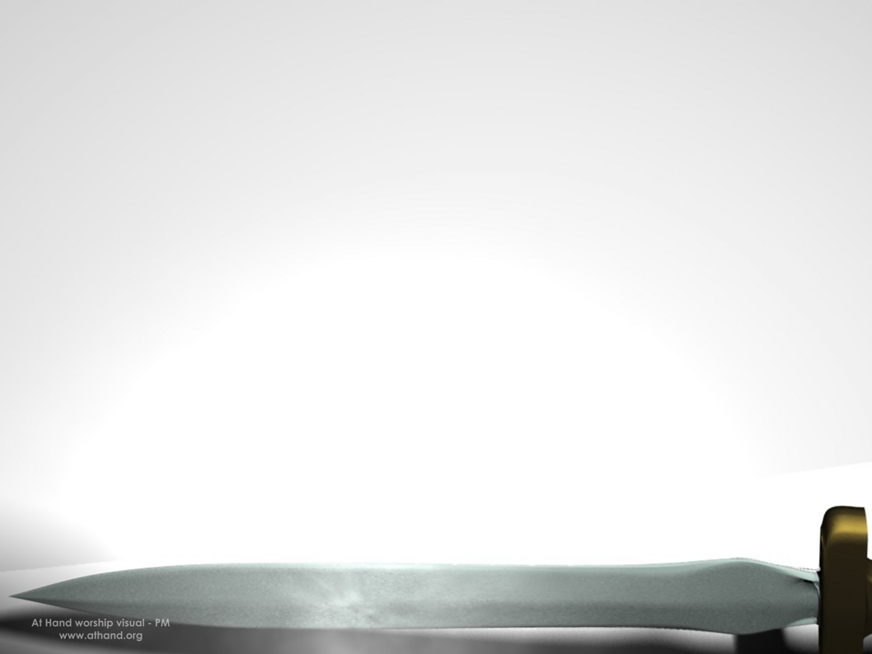
Scripture Memory Verse
2 Timothy 2:15
“Be diligent to present yourself approved to God as a workman who does not need to be ashamed, accurately handling the Word of truth”
Notes:
Warm up-Review Memory verse:
<ask volunteers if they can recite last weeks verse>
<Ask volunteers to recite this weeks verse>

Slide 3
DEFINE: Diligence & Accurately
Diligence-
  careful and persistent work or effort.
Accurately-
  free from error or defect; precise; exact
Notes:
II. Define two words:
Diligence- careful and persistent work or effort.
Accurately- free from error or defect; precise; exact
<Say:> To handle God’s Word accurately is not and easy task; it takes work, but it is commanded by God.
To handle the Scripture accurately means to “Cut it straight,” finding the true meaning.

Slide 4
THE 5 WAYS TO KNOW THE BIBLE
  1. Hear it
  2. Read it
  3. Study it
  4. Memorize it
  5. Meditate on it
Notes:
What are the 5 ways to know the Bible and why are these important?
1. Hear it
2. Read it
3. Study it
4. Memorize it
5. Meditate on it

Slide 5
WHY SHOULD WE STUDY THE BIBLE?
To be approved by God
To grow in salvation
To not sin against God
To revere God
For guidance
Notes:
<ASK> Why Should we study the Bible? (Look at your worksheets in Section I)
*To prepare yourself for service (1 Peter 3:15; 1 Timothy 4:6)
*To sanctify our lives (John 17:17; 1 Peter 1:14-19)
*It is God’s will that we dwell on the Word and obey it (Joshua 1:8; Colossians 3:16)
*Understanding Scripture helps Christians know God more deeply (John 5:39; Prov. 2:1,5; 1 John 2:14)

Slide 6
WHY SHOULD WE STUDY THE BIBLE?
We study Scripture because it is Sufficient!
2 Timothy 3:16
Notes:
Q: Why do we study Scripture:
A: Because it is Sufficient!
Can anyone cite, 2 Timothy 3:16?

Slide 7
  2 Timothy 3:16
  All Scripture is inspired by God and profitable for teaching, for reproof, for correction, for training in righteousness.

Slide 8
HOW DO WE KNOW THE BIBLE?
Hear it
1 Timothy 4:13 (NASB)
“Until I come, give attention to the public reading of Scripture, to exhortation and teaching.”
Notes:
<SAY> So, HOW do we know the Bible?
A. HEAR IT: (Why do we have to hear it?)
Q: (Is this more than just reading it on our own?)
A: Yes, There is a need for us to hear God’s Word Read in Public
1 Timothy 4:13 says,

Slide 9
HOW DO WE KNOW THE BIBLE?
Hear it
2 Timothy 4:1-2 (NASB)
“I solemnly charge you in the presence of God and of Christ Jesus, who is to judge the living and the dead, and by His appearing and His kingdom: preach the word; be ready in season and out of season; reprove, rebuke, exhort, with great patience and instruction.”
Notes:
<SAY> So, HOW do we know the Bible?
A. HEAR IT: ALSO
There is a need to hear the Preaching of Scripture:
2 Timothy 4:1-2 says, “I solemnly charge you in the presence of God and of Christ Jesus, who is to judge the living and the dead, and by His appearing and His kingdom: preach the word; be ready in season and out of season; reprove, rebuke, exhort, with great patience and instruction.”
WHAT THIS IS NOT… this is not preaching man’s OPINIONS or CULTURAL trends!
NOTE: it is also important to hear the Word preached on a regular basis.

Slide 10
HOW DO WE KNOW THE BIBLE?
Read it/Study it
Notes:
B. READ IT
Get a plan! Read a whole book (or for longer books at least 10 chapters) a day every day for a month
This way you will grasp more easily the authors intent and flow of thought
and it will help you to retain more

Slide 11
HOW DO WE KNOW THE BIBLE?
Memorize it
  Psalm 119:11 (NASB)
“Your word I have treasured in my heart, That I may not sin against You.”
Notes:
C. MEMORIZE IT: <ASK> Why is memorizing the Word of God so important?
<TELL THEM>:look at your worksheet Section II, D, 2-3
Psalm 119:11 Says, “Your word I have treasured in my heart, That I may not sin against You.”
<ASK> Q: How many of you would like to be able to share the Gospel with others anytime?
Q: IF so, what do you need to know?
A: Gospel verses, memorized!

Slide 12
HOW DO WE KNOW THE BIBLE?
Meditate on it
Notes:
C. MEDITATE ON IT: <READ> Psalm 1:1-3 & Joshua 1:8 (noted in your worksheets)
<

Slide 13
Psalm 1:1-3 (NASB)
How blessed is the man who does not walk in the counsel of the wicked, Nor stand in the path of sinners, Nor sit in the seat of scoffers! But his delight is in the law of the Lord, and in His law he meditates day and night. He will be like a tree firmly planted by streams of water, which yields its fruit in its season and its leaf does not wither; and in whatever he does, he prospers.
Notes:
READ

Slide 14
Joshua 1:8 (NASB)
This book of the law shall not depart from your mouth, but you shall meditate on it day and night, so that you may be careful to do according to all that is written in it; for then you will make your way prosperous, and then you will have success.
Notes:
READ

Slide 15
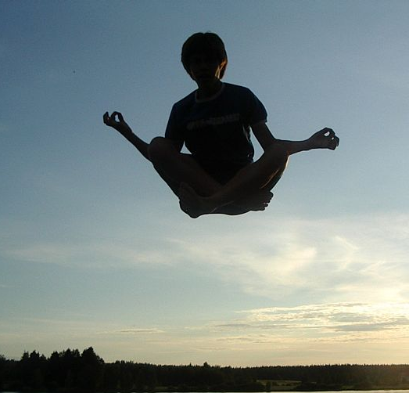
HOW DO WE KNOW THE BIBLE?
Meditate on it:
  Meditation is NOT…
Notes:
C. MEDITATE ON IT: <READ> Psalm 1:1-3 & Joshua 1:8 (noted in your worksheets)
<ASK> What does it mean to meditate on Scripture?
ANSWER: TO ponder on; to think upon prayerfully with a goal to a fuller understanding and application
<NOTE> Meditation is not emptying your mind of all conscious thought… It’s not what you think of as you see in Eastern Religions. Don’t confuse that with Biblical meditation. Eastern religions urge followers to meditate on emptiness or nothing, while Biblical meditation is focusing and thinking deeply about– GODs WORD!

Slide 16
HOW DO WE KNOW THE BIBLE?
Meditate on it:
  CHEW and DIGEST
  DAY and NIGHT (Psalm 1:2)
  UNDERSTANDING and APPLYING
  CONFORMING TO HIS WILL
Notes:
C. MEDITATE ON IT: <READ> Psalm 1:1-3 & Joshua 1:8 (noted in your worksheets)
<ASK> What does it mean to meditate on Scripture?
ANSWER: TO ponder on; to think upon prayerfully with a goal to a fuller understanding and application
<NOTE> Meditation is not emptying your mind of all conscious thought… It’s not what you think of as you see in Eastern Religions. Don’t confuse that with Biblical meditation. Eastern religions urge followers to meditate on emptiness or nothing, while Biblical meditation is focusing and thinking deeply about– GODs WORD!
We CHEW and DIGEST it
We Meditate on it DAY and NIGHT (Psalm 1:2)
IT”S prayerful reflection as to understanding and applying
It’s goal is conforming our life and our thoughts to HIS WILL

Slide 17
HOW DO WE KNOW THE BIBLE?
Meditate on it:
  LET’S DO IT!
      ROMANS 10:9
Notes:
C. MEDITATE ON IT:
WE are going to practice…

Slide 18
Romans 10:9 (NASB)
If you confess with your mouth Jesus as Lord, and believe in your heart that God raised Him from the dead, you will be saved.
Notes:
READ: Everyone is going to read the verse OUT LOUD…
Each person takes a turn, one after the other, the first person will emphasize the first word, the next the next word and so on.
And ponder the verse from the standpoint of each word and how it affects the meaning.

Slide 19

THE BIBLE STUDY PROCESS
Hermeneutics- Formal rules for studying the Bible
Objective Hermeneutics- allowing the text to speak for itself
Notes:
Hermeneutics- Formal rules for studying the Bible
Objective Hermeneutics- allowing the text to speak for itself
It does NOT “read into the text” what we think or how we feel
Hermeneutics considers several aspects of the text:
The Historical, grammatical, cultural nature and context of the passage…
This enables the reader to understand what the original writer meant to say.

Slide 20
THE BIBLE STUDY PROCESS
STEP 1: PREPARATION
Notes:
STEP 1: Preparation-
REVIEW: Section III, A, in your lesson
<EMPHASIZE> Confession 1 John 1:9

Slide 21
James 1:21 (NASB)
Therefore, putting aside all filthiness and all that remains of wickedness, in humility receive the word implanted, which is able to save your souls
Notes:
<ASK> Q: How are we to approach the Word of God?
A: In Purity and Humility

Slide 22
THE BIBLE STUDY PROCESS
STEP 1: PREPARATION
Notes:
STEP 1: Preparation-
LOOKIN AT: Section III, A, 2
Is there a need for us to pray for understanding?

Slide 23
THE BIBLE STUDY PROCESS
STEP 2: OBSERVATION
Notes:
STEP 2: Observation
Q: What is observation?
What type of observations questions can you ask?
<Say> Simply write down questions on what you are studying and then find the answers
On your worksheet Section III, B, 2… Q: what are some things you can look for in a passage?
<Say> Bible study starts with asking questions then finding answers!

Slide 24
THE BIBLE STUDY PROCESS
STEP 3: INTERPRETATION
Notes:
STEP 3: Interpretation
<First> review the info in the lesson III, C
<ASK> How would finding other passages in the Bible that talk about the same subject as the passage at hand help in your interpretation of a verse?
<ASK> Why have believers always said that the best commentary on the Bible is the Bible itself?
<REVIEW BIBLE STUDY TOOLS>

Slide 25
THE BIBLE STUDY PROCESS
STEP 4: APPLICATION
Notes:
STEP 4: Application
<ASK> What does it mean to put on the SPECS as part of Bible study?
How should one looking into God’s Word affect the way we look at our lives?

Slide 26
THE BIBLE STUDY PROCESS
STEP 5: REPETITION
Notes:
STEP 5: Repetition
<ASK> Q:Why is studying a verse a repetitious process?
A: One pass through a passage– Observing, interpreting, and applying – is not enough.
This process needs to be repeated, over and over,
until the deeper meaning of the passage is opened to you.

Slide 27
THE BIBLE STUDY PROCESS
STUDY EXERCISE (SECTION IV)
Notes:
<<Say> Turn to Section IV in your worksheets…
We are going to share the different observations, interpretive questions, and interpretations you noted about this verse (Matthew 6:33)
(Each time, ask the rest of the group if others saw that point. Make sure that the observations made are truly in the passage and not read into it)
<SAY> will anyone share your applications from this exercise?
<SAY> We must note that while interpretations of a passage should be uniform, there can be many personal or general applications of the truth in a passage.

Slide 28
THE BIBLE STUDY PROCESS
APPLICATION
Notes:
<<ASK> Did filling out a chart like this reveal anything about your personal priorities?
This chart functions like an accountability partner.
<ASK> Would anyone want to share how they plan to change their Bible Study habits as a result of this lesson?

Slide 30
Give Us Clean Hands
We bow our hearts We bend our knees
Oh Spirit come make us humble
We turn our eyes from evil things
Oh Lord we cast down our idols

Slide 31
Give Us Clean Hands
Give us clean hands give us pure hearts
Let us not lift our souls to another (repeat)
And oh God let us be a generation that seeks
That seeks your face oh God of Jacob (repeat

